Slide 1
AI developer bootcamp: Vision
James Carpinter
CTO, Zarmada | Microsoft Regional Director
james@zarmada.com | @jamescarpinter

Slide 2
How do I understand the contents of the images my users upload?
How do I distinguish between different car types?
How do I recognize my users?
Language
Dynamics 365
Skype
Knowledge
Speech
Browser
Azure Bot Service
Cognitive Services
Vision
Cortana
Web
Azure ML
Cognitive Toolkit

Slide 3





Computer Vision
Face
Emotion
Custom Vision
Content Moderator
Video Indexer

Slide 4
Computer Vision
Face
Emotion
Custom Vision
Content Moderator
Video Indexer

Slide 5
Computer Vision
General purpose image analysis
Analyze in multiple dimensions through single API call; or use scoped operations
Pass images as binary content or URLs; JPG, PNG, GIF, BMP
Tags etc. available in EN, ZH
Not designed for object classification or domain-specific concepts
Analyze
Tags, categories, faces, descriptions, colors
Extract text
Machine generated, handwriting (preview)
Domain-specific
Celebrities, landmarks; flag adult content
Thumbnails
Crop to region of interest and aspect ratio

Slide 7
Computer Vision: Analyze
Categories
"categories": [ { "name": "people_swimming", "score": 0.98046875, "detail": { "celebrities": [] } } ]
Description
"captions": [ { "text": "a man swimming in a pool of water", "confidence": 0.890929810561329 } ]

Slide 8
Computer Vision: Analyze
Tags
"tags": [ { "name": "water", "confidence": 0.9997857213020325 }, { "name": "swimming", "confidence": 0.9556196331977844 }, { "name": "sport", "confidence": 0.9538078308105469 }, { "name": "pool", "confidence": 0.9515978097915649 }, ...

Slide 9
Computer Vision: Analyze
Face
"faces": [ { "age": 36, "gender": "Male", "faceRectangle": { "left": 298, "top": 133, "width": 121, "height": 121 } } ]

Slide 10
Computer Vision: Analyze
Colors
"color": { "dominantColorForeground": "Grey", "dominantColorBackground": "White", "dominantColors": [ "White" ], "accentColor": "19A4B2", "isBWImg": false }, "imageType": { "clipArtType": 0, // False "lineDrawingType": 0 // False }

Slide 11

Computer Vision: Extract text
OCR
Designed for continuous text with linear structure & good contrast
Supports 25 languages
Built-in rotation correction
{
"language": "en",
"orientation": "Up",
"regions": [
{
"boundingBox": "41,77,918,440",
"lines": [
{
"boundingBox": "41,77,723,89",
"words": [
{
"boundingBox": "41,102,225,64",
"text": "LIFE"
},
{
"boundingBox": "356,89,94,62",
"text": "IS"
}, ...

Slide 12
Computer Vision: Extract text
Handwriting
Still in preview and only supports EN
Asynchronous processing model
Supports text on whiteboards, paper, sticky notes to digitize different inputs
Also supports rotation correction
{ "status": "Succeeded",
"succeeded": true,
"failed": false,
"finished": true,
"recognitionResult": {
"lines": [
{
"boundingBox": [ 354, 196, ... ],
"text": "Be yourself",
"words": [
{
"boundingBox": [ ... ],
"text": "Be"
},
{
"boundingBox": [ ... ],
"text": "yourself" ...

Slide 13

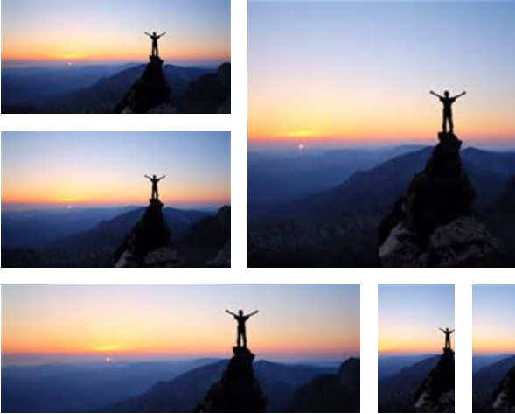
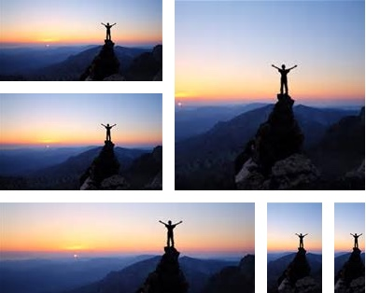



Computer Vision: Thumbnails
Original
Smart crop OFF
Smart crop ON

Slide 14
Computer Vision
Face
Emotion
Custom Vision
Content Moderator
Video Indexer

Slide 15
Face & Emotion
Specialized computer vision API designed for human faces
Submit binary or URL; can operate on up to 64 faces
Designed for full, front facing faces rather than side profile
Emotion API is standalone; however, now available as part of Face API Detect operation
Extra $ for stored faces
Detect & analyze
Landmarks, age, gender, hair, glasses, hair…
Find similar faces
For a given face, find similar faces in a set
Group faces
For a set of faces, group by similarity
Identify & verify
Who is this? Is this who I think it is?

Slide 16


Slide 17
Face & Emotion: Detect & analyze
Identity
"faceId": "6d05a704-10fc-4077-..."
Location
"faceRectangle": { "top": 139, "left": 245, "width": 129, "height": 129 }, "faceLandmarks": { "pupilLeft": { "x": 280.6, "y": 176.7 }, "pupilRight": { "x": 335.8, "y": 172.5 } ...

Slide 18
Face & Emotion: Detect & analyze
Hair
Makeup
Occlusion
Accessories
Blur
Exposure
Noise
Attributes
Age
Gender
Smile intensity
Facial hair
Head pose
Glasses
Emotion

Slide 19
Face & Emotion: Detect & analyze
Attributes
"gender": "male", "age": 41.5, "facialHair": { "moustache": 0.4, "beard": 0.6, "sideburns": 0.6 }, "emotion": { "anger": 0, "contempt": 0, "disgust": 0, "fear": 0, "happiness": 1, "neutral": 0, "sadness": 0, "surprise": 0 }, "hair": { "bald": 0.01, "hairColor": [ { "color": "brown", "confidence": 1 } ] }

Slide 20
Face & Emotion: Identify & verify
1. Create person
Provides unique identifier for use with a specific operation
Requires a person group
2. Add face & train
Add one or more faces to the person
Train person group before using it with identify
3. Recognize
Identify: pass list of face IDs or person group
Verify: pass expected face ID or person ID

Slide 21
Computer Vision
Face
Emotion
Custom Vision
Content Moderator
Video Indexer

Slide 22
Custom Vision
Build a custom image classifier in 10 minutes or less
Diversity of images is key: angles, lighting, backgrounds
Not for object detection and is robust to subtle differences
Handles tuning model for edge cases (like misses)
Check the ToS: images are retained (in preview), limits on images/tags/predictions
Upload
Start with as little as 30 – 50 images per tag
Train
Build model on one of five featurizers
Predict
Deploy REST endpoint; identify 1+ tags
Iterate
New images are retained for tagging

Slide 23



Custom Vision
“cat”
Custom Vision
Model
“dog”
“dog”

Slide 24
Demo
Vision

Slide 25
Computer Vision
Face
Emotion
Custom Vision
Content Moderator
Video Indexer

Slide 26
Content Moderator
Ensure user-generated content is appropriate before showing on your website
Not just adult images: profanity in 100+ languages, OCR over images, and PII detection
Automated moderation is augmented with human review as needed
Web portal for review team; currently only MSA
All content types
Text & images plus video in Media Services
Extensible
Text Analytics, Computer Vision, and more
Workflows
Drive classification based on your logic
Human review
Flag for manual review when required

Slide 27
Computer Vision
Face
Emotion
Custom Vision
Content Moderator
Video Indexer

Slide 28
Video Indexer
Extract insight and build sophisticated indexes of your video content
Re-define video search; opens up options for monetization (ad placement) as well as user engagement
RESTful API and embeddable HTML widgets
N.B. API portal distinct from front-end web app
Upload & go
Videos are processed asynchronously
Improve accessibility
Automatic audio transcription & translation
Speaker detection
Detect people and their sentiment
Content analysis
Keywords, visual text, annotations, key frames

Slide 29
Demo
Video Indexer

Slide 30
What do I use then?
EASY
MODERATE
ADVANCED
Computer Vision
General purpose image classifier
Face & Emotion
Some training required before users can be identified/verified
Video Indexer
Needs to be integrated into site via widgets or custom UX
Custom Vision Requires training data and iterative improvement; not that advanced ☺
Content Moderator Starts easy with automated moderation; human review requires workflows, teams, and integration

Slide 31
How do I understand the contents of the images my users upload?
Computer Vision
How do I distinguish between different car types?
Custom Vision
How do I recognize my users? Face
Language
Dynamics 365
Skype
Knowledge
Speech
Browser
Azure Bot Service
Cognitive Services
Vision
Cortana
Web
Azure ML
Cognitive Toolkit

